Slide 1
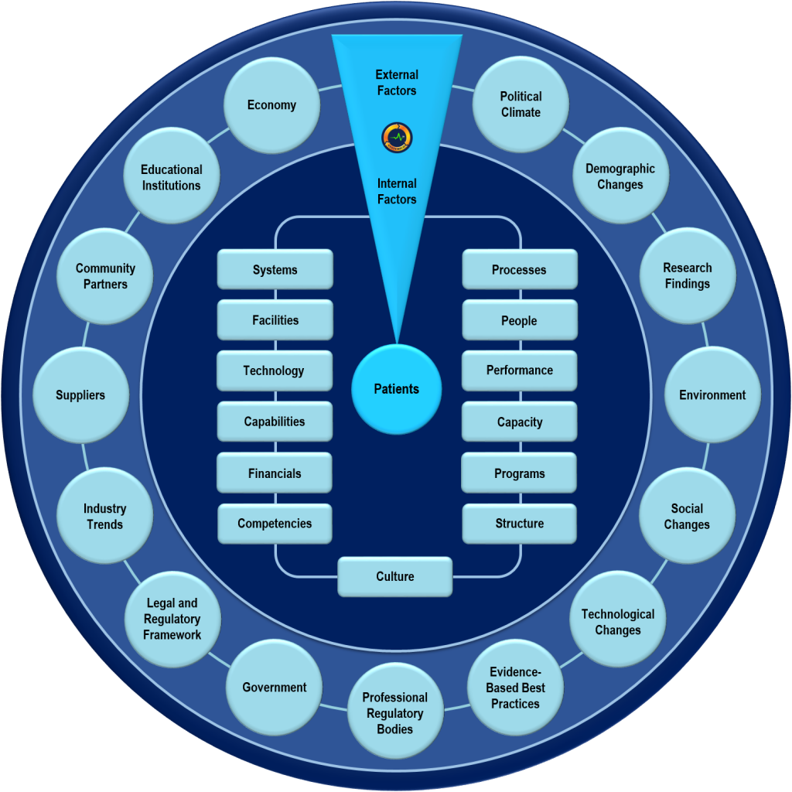
Analysing the External Environment of the Firm

Slide 2
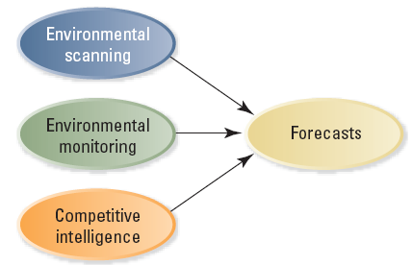

Inputs to Forecasting
2-<number>

Slide 3

How to Spot Hot Trends
Listen
Pay attention
Follow trends online
2-<number>
Notes:
Ask your customers questions about your products and services
Read trade publications related to your industry
Add websites like trendhunter.com to your regular surfing
Ask your customers what they think

Slide 4

Environmental Forecasting
Environmental forecasting
  The development of plausible projections about direction, scope, speed and intensity of environmental change
2-<number>

Slide 5

Environmental Forecasting
Scenario analysis
  An in-depth approach to environmental forecasting that involves experts’ detailed assessments of societal trends, economics, politics, technology, or other dimensions of the external environment
2-<number>

Slide 6
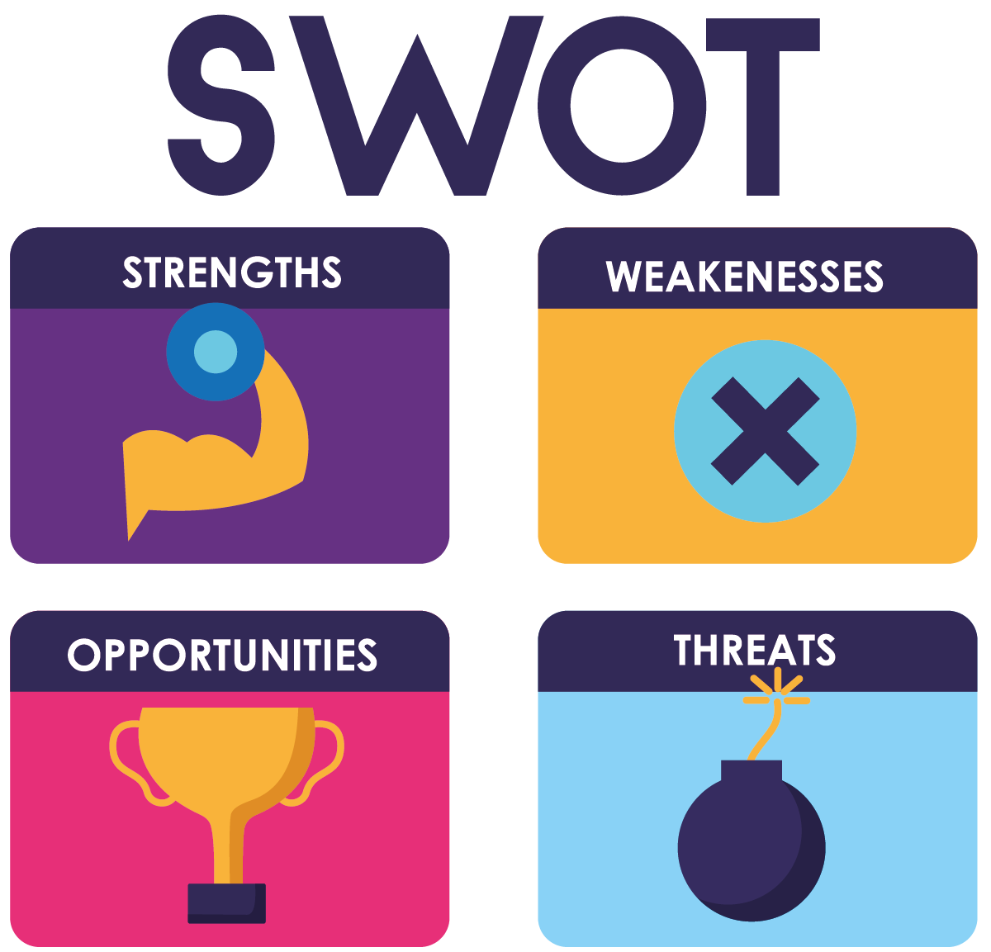
SWOT Analysis
Firm’s strategy must:
Build on its strengths
Remedy the weaknesses or work around them
Take advantage of the opportunities presented by the environment
Protect the firm from threats
2-<number>

Slide 7
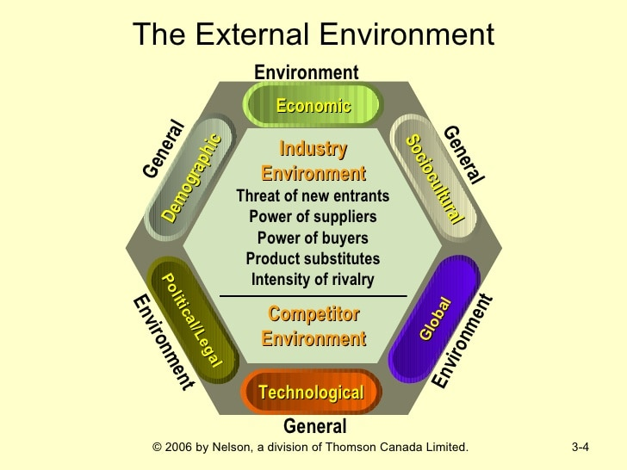
The General Environment
Factors external to an industry, usually beyond a firm’s control
Demographic
Sociocultural
Legal/Political
Technological
Economic
Global
2-<number>
Notes:
General environmental trends and events:
Little ability to predict them
Even less ability to control them
Can vary across industries

Slide 8

Demographic Segment
Aging population
Rising or declining affluence
Changes in ethnic composition
Geographic distribution of population
Greater disparities in income levels
2-<number>
Notes:
Demographic segment of the general environment
genetic and observable characteristics of a population, including the levels and growth
of age, density, sex, race, ethnicity, education, geographic region, and income.

Slide 9

Sociocultural Segment
More women in the workforce
Dual-income families (DINK)
Increase in temporary workers
Greater concern for healthy diets and physical fitness
Greater interest in the environment
Postponement of having children
2-<number>
Notes:
Sociocultural forces influence the values, beliefs, and lifestyles of a society

Slide 10

Political/Legal Segment
Data Protection Act (1998)
Deregulation of utility and other industries
Increases in federally mandated minimum wages
Taxation at local, state, federal levels
Migration
2-<number>

Slide 11

Technological Segment
Genetic engineering
Emergence of Internet technology
Computer-aided design/computer-aided manufacturing systems (CAD/CAM)
Wireless communication
Nanotechnology
2-<number>
Notes:
Genetic engineering
Emergence of Internet technology
Computer-aided design/computer-aided manufacturing systems (CAD/CAM)
Research in synthetic and exotic materials
Pollution/global warming
Miniaturization of computing technologies
Wireless communication
Nanotechnology

Slide 12

Economic Segment
Interest rates
Unemployment
Consumer Price index
Trends in GDP
Changes in stock market valuations
2-<number>

Slide 13

Global Segment
Increasing global trade
Currency exchange rates
Emergence of the BRICS economies
Trade agreements (NAFTA, EU, ASEAN)
Creation of WTO (decreasing tariffs/free trade in services)
2-<number>

Slide 14

The Competitive Environment
Competitive environment
  factors that pertain to an industry and affect a firm’s strategies
Competitors, customers, and suppliers
2-<number>

Slide 15
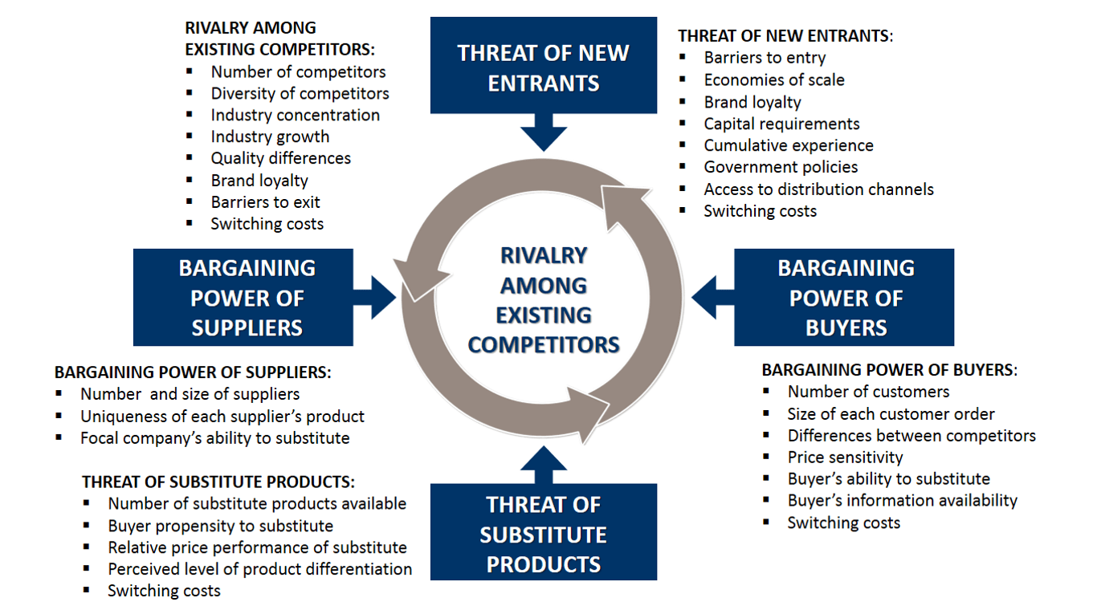
Porter’s Five Forces Model of Industry Competition
2-<number>

Slide 16

Strategic Groups within Industries
Two unassailable assumptions in industry analysis
  No two firms are totally different
  No two firms are exactly the same
Strategic groups
  Cluster of firms that share similar strategies
2-<number>
Notes:
Strategic groups
Cluster of firms that share similar strategies
Breadth of product and geographic scope
Price/quality
Degree of vertical integration
Type of distribution system

Slide 17

Strategic Groups within Industries
Value of strategic groups as an analytical tool
  Identify barriers to mobility that protect a group from attacks by other groups
  Identify groups whose competitive position may be marginal or tenuous
  Chart the future direction of firms’ strategies
  Thinking through the implications of each industry trend for the strategic group as a whole
2-<number>

